Slide 1
Culture/climate Survey: Home connection & Staff Retention
Kyrstn Was
Culture, Politics and Reform
Spring Semester 2016

Slide 2
Section 1

Slide 3
Purpose of this project…
The purpose of this project was to assess my school’s culture and climate, the influence of culture and climate on student learning, and the strengthens / challenges within our school.

Slide 4
the culture of the united states education today
Through the course of my last two semesters, I have come to the conclusion that the educational landscape in the United States is in a state of constant flux. Public schools are constantly changing, adopting new curricula, assessments to measure student growth and performance, creating new mechanisms for participation in decision making and a myriad of other modifications in order to keep up with the constant changes within the political powers at the state and national level. Marshal and Gerstl-Pepin (2004) explain, “Individual states’ roles in developing education policy relate to each state’s unique political conditions” (p. 158). As the political arena constantly changes, so does the policies that impact public education. Changes also occur with members of local school boards, who draw on their personal agendas to make decisions that impact the educational learning within the local schools. Marshall and Gerstl-Pepin (2004) point out, “Policy makers have different orientations to their roles: Some are delegates bound to follow their constituency’s instructions, and some are trustees, entrusted to make good decisions” (p.17). As policies and political leaders change, it is unfortunate that so too will the educational system.

Slide 5
the culture of the united states education today
As we approached the 21st century, the public school system also faces the threat of the neoliberal agenda. With the neoliberal assault on public education, their view is to privatize education and make it a commodity (English, 2014). By doing this, the neoliberal agenda is trying to do away with public schools. Their agenda is to push for new a educational model, transferring public education to a school voucher program that intends to make a profit (English, 2014). With the increase of school choice or charter schools, local school districts are losing money to these for-profit schools. Charter schools on the other hand are publicly funded schools and are freed from public school system rules and regulations in exchange for lack luster accountability from states to produce positive, measurable student results. Therefore, public schools are traded in for profit based education corporations that care more for financial profit than the individual education of students. English (2014) explains, “When education is about making a profit then that’s what it becomes first and foremost, a means to make a profit. Everything else becomes secondary” (p. 37).

Slide 6
School climate team
Kyrstn Was: Instructional Coach
Stephanie Davis: Principal
Christopher Gruska: Assistant Principal
Krissy Oeltjen: School Counselor
Brian Hill: School Psychologist
Lexi Matt: Intervention Specialist/3rd Grade Teacher
Jennifer Bechtel: Reading Specialist

Slide 7
Section 2
Discussion with school leader

Slide 8
conversation with Principal
Met with my principal and discussed school culture and climate and the nature of the inquiry based project.
A school culture must have every member of a school community — teachers, students, family members — work together toward the school’s shared vision. – Building Principal
During my conversation with the principal, the principal decided the most crucial issue affecting the school’s culture and climate that has a profound impact on students' learning was parental/guardian connection.
The over arching theme throughout this critical dialogue was how to improve the connection from home to school and expand parent involvement.

Slide 9
What I learned from my conversation with Principal
Based on the conversation with the principal, her main concern is impacting our school’s home connection.
The school’s home connection needs to address:
Helping families learn new strategies to support their students’ academic needs.
Building a trusting relationship with families.
Home Visits/Off-site Visits: Making positive contact and building positive relationships with families
Create formal and informal opportunities to build trust between home and school

Slide 10
Responding to questions
My school community understands learning and the impact it has on the future of our students.
Problems are identified within the school community in multiple ways:
Student issues
Office Referrals
Student Staffing
Staff issues:
Building Concerns addressed at monthly staff meetings
The politics of policy implementation are seen in the rules and regulation governed by the school and implemented into actual classroom practices on a day-to-day basis
The traditions associated with policy analysis are decisions about policy and educational protocol as determined on the district level.
What is missing from policy analysis is the input from schools about some implementations of decisions and policies decided by the district.
The school community members do not understand or have never heard ‘micropolitics’.
Critical questioning exists during PLCs and some student staffing (referrals).
My school community is comprised of teachers and educational assistants, who work with a challenging population of students and see the potential in every student.

Slide 11
Responding to questions
I feel engaging people in questions deepens their understanding regarding social justice and equity work in schools. By engaging in dialogue pertaining to social justice and equity, people can gain insights on and allow for the discussion to continue.
I learned that my principal has some understanding of social justice and equity work needed in schools. Her understanding is based on the Equity Project completed during the fall 2015 semester. Through the inquiry based project, the principal learned what equity means and how it impacts schools.
My understanding of social justice and equity have increased from the Equity Project I completed during the fall 2015 semester. The equity audit process, leaves me with the responsibility to figure out experiences for ALL teachers and staff that serve students in meaningful ways to develop our school’s equity consciousness.
Based on my conversation with the principal, I wanted to see if the School Climate Team viewed home connection as a priority. Next, I was anxious to see if any School Climate Team member would prioritize the issue of staff retention because this was not a concern of the building principal.
In my discussion with the principal, I did not utilize any resources (readings, video clips etc.) because the conversation was too brief to expand other areas of concern that may impact our school’s climate or culture.
At the conclusion of our meeting, we accessed the necessary questions to ask of the School Climate Team.

Slide 12
Section 3
School Climate team members

Slide 13
School climate team
Kyrstn Was: Instructional Coach
Stephanie Davis: Principal
Christopher Gruska: Assistant Principal
Krissy Oeltjen: School Counselor
Brian Hill: School Psychologist
Lexi Matt: Intervention Specialist/3rd Grade Teacher
Jennifer Bechtel: Reading Specialist

Slide 14
School climate team
The School Climate Team was selected / asked to serve as a member of this project because each person currently is a member of the School Leadership Team (SIP) at Bridges Learning Center.

Slide 15
What role does each member play on this team?
Each members’ role on the School Climate Team was:
To attend meetings
Meetings were March 10th , April 8th , and April 21st
Actively involved in discussions
Communicate their learning to others on the team to create solutions to improve the school climate of Bridges Learning Center.

Slide 16
Critical Dialogue: the Process of selecting School Community stakeholders
Critical dialogue with members of the School Climate Team was the first step in deciding how the school’s culture and climate influenced the culture and climate of our students' learning.
Team members engaged in dialogue pertaining to our school’s climate and the missing factor was the home connection piece with families.
All team members commented on how do we, as a school, get parental/guardian engagement in their child’s education.
The over arching theme throughout this critical dialogue was how to improve the connection from home to school and expand parent involvement.

Slide 17
Common beliefs survey
A Common Beliefs Survey was sent via email to members of the School Climate Team at Bridges Learning Center.
The survey was created in Google Docs and shared with each member of the School Climate Team.
The purpose of the survey was to assess school community members’ understanding of our schools culture and climate.
The information gathered from the survey will help to guide our understanding of the team members perceptions of the schools culture and climate and how this influences current practice and policy in our school.

Slide 18
Common beliefs survey
The Common Beliefs Survey was completed by 5 out of the 6 School Climate Team members.
Since a survey was used to gather information from the School Climate Team, the Likert scale was used to request an assessment of variable from among a range of potential responses.
The Likert response format provided five options from (1) Strongly Agree to (5) Strongly Disagree .
The Common Belief Survey contained 10 questions.

Slide 19
survey questions used to gather team insights
Students feel safe in our school.
Students feel their teachers care about them.
Students feel their principal cares about them.
Families feel comfortable gaining access to our school.
Families are comfortable with understanding what their children are learning in school.
Families feel welcome in our school.
Families are considered partners or adversaries in their child’s education.
Families describe our school favorably.
Families feel listened at our school.
Students feel rewarded with their work in school.

Slide 20
Section 4
Results of finding

Slide 21
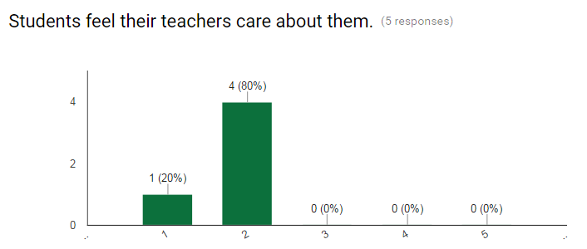
Results of findings
2 out of 5 team members, or 40%, disagreed that students feel safe at our school
4 out of 5 team members, or 80%, agreed that students feel their teachers care about them.
1= Strongly Agree
3= Neutral
5= Disagree Strongly

Slide 22
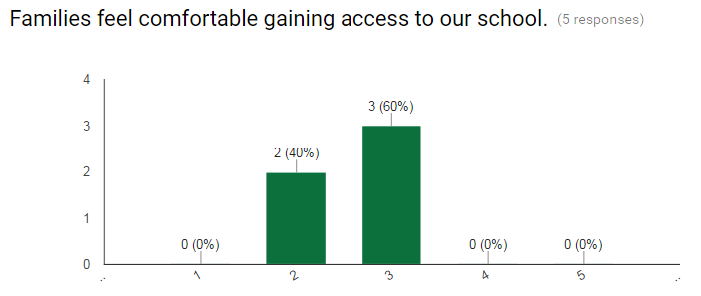
Results of findings
3 out of 5 team members, or 60%, agreed that students feel the principal cares for them.
3 out of 5 team members, or 60%, are neutral that families feel comfortable gaining accessing our school.
1= Strongly Agree
3= Neutral
5= Disagree Strongly

Slide 23
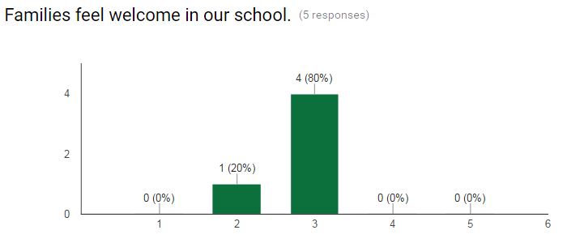
Results of findings
1 out of 5 team members, or 20%, strongly disagreed and 3 out of 5, or 60%, disagreed that families are comfortable understanding what their children are learning.
4 out of 5 team members, or 60%, are neutral that families feel welcome in our school.
1= Strongly Agree
3= Neutral
5= Disagree Strongly

Slide 24
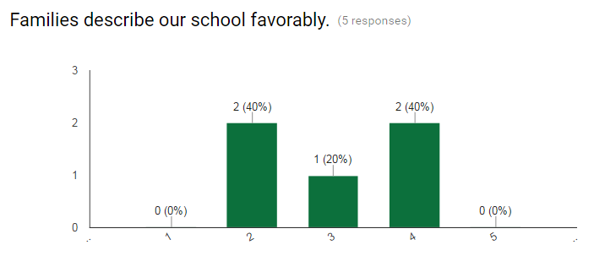
Results of findings
3 out of 5 team members, or 60%, agreed families are partner or adversaries in their child’s education.
2 out of 4 team members, or 40%, agreed and 2 out of 4, 40%, disagreed families describe our school favorably..
1= Strongly Agree
3= Neutral
5= Disagree Strongly

Slide 25
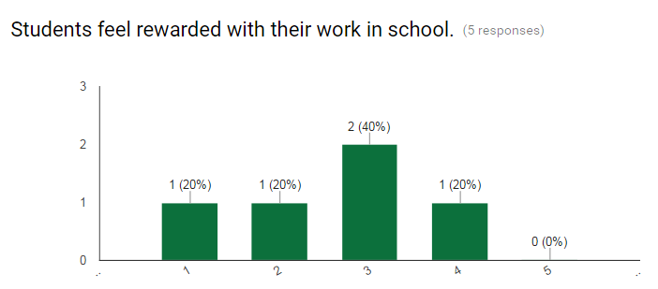
Results of findings
3 out of 5 team members, or 60%, disagreed families fell listened at our school.
2 out of 5 team members, or 40%, are neutral students feel rewarded with their work in school.
1= Strongly Agree
3= Neutral
5= Disagree Strongly

Slide 26
Additional dialogue with Team members
What does it mean to speak truth to people about the reality of children’s lives?
Truly knowing our students and community- Assistant Principal
Being honest about their home lives and understanding their individual circumstances- School Counselor
To what extent do we as a school community encourage people to action?
It is the responsibility of the principal—the person with the most power in the school-to set the stage / example to take action, not just because they are the principal, but truly for caring the school community- Assistant Principal
Building relationships that make others feel “safe” – School Psychologist
Letting our students know they are capable of anything, with the right support- Reading Specialist

Slide 27
Critical Dialogue: Staff retention
Several Team members mentioned the “revolving door” of teachers the past several years.
Since the beginning of the 2013-2014 school year, Bridges Learning Center has needed to fill 4-5 teaching positions each school year.
The operation of the school requires 13 full time intervention specialist (Special Education Certified).
The 2015-2016 school year, the school was unable to fill 3 teaching positions with high quality teachers. Therefore, 3 classrooms have functioned with 3 long-term substitute teachers.

Slide 28
Critical Dialogue: Staff retention
How can Bridges Learning Center retain quality teachers?
Although policymakers can mandate and fund recruitment and induction programs, only school leaders can foster the full range of supports that teachers need- School Psychologist
We should have been focusing on improving staff working conditions; creating more unity among the staff members. Having veteran staff mentor new staff with all the different nuisances that makes our building unique. – School Counselor
Bridges Learning Center needs to be committed to keeping quality teachers and staff and to develop successful strategies and supports to assist new teachers and to keep veteran teachers. –Instructional Coach

Slide 29
Results shared with Principal
The results from the survey and additional dialogue were shared with the principal. The principal noticed the mention of staff retention at Bridges Learning Center. The principal felt this was an over-sight on her part for not considering it an area of critical need when addressing school culture and climate.

Slide 30
Reflection
I learned throughout this process of surveying and verbally questioning the team members, that each member was thoughtful in their responses both on the survey and engaging in critical dialogue. The results from the survey were not a surprise, nor the critical dialogue.
The new questions I had were addressed with the critical dialogue I had with the School Climate Team. I felt these additional questions would be beneficial in determining what is needed at this school.
School climate sets the tone for all the learning and teaching done in the school environment. While school culture is central to a school’s success. School culture fosters improvement, collaborative decision making, professional development and staff and student learning.
School climate and culture influence and promote social justice and equity work in schools by an equitable school climate responding to the wide range of cultural norms, goals, values, interpersonal relationships, leadership practices, and organizational structures within the broader community (Marshall & Oliva, 2006).

Slide 31
Section 5
Research-based solution

Slide 32
4 strengths
The School Climate Team responded favorably to students feeling cared for in their classroom. 4 out of 5 team members, or 80%, agreed that students feel their teachers care about them.
3 out of 5 team members, or 60%, agreed families are partners or adversaries in their child’s education. This means that 3 School Climate Team members believe families support student learning, along with creating, revising, and renewing Individual Student Education plans (IEPs).
4 out of 5 team members, or 60%, are neutral that families feel welcome in our school. This is considered a strength because the School Climate Team members who responded neutral have no opinion on families feeling welcome at our school, so it could be assumed that they feel families are not being unwelcomed either.
1 out of 5 team members, or 20%, strongly agreed and 1 out of 5 team members, or 20%, agreed that students felt rewarded at our school. This is considered a strength because students at our school earn positive rewards based on their behavior.

Slide 33
2 challenges
2 challenges facing the school community regarding school culture and school climate are:
Home Connection
The school’s home connection needs to address:
Home Visits/Off-site Visits: Making positive contact and building positive relationships with families
Create formal and informal opportunities to build trust between home and school
Staff Retention
The operation of the school requires 13 full time intervention specialist (Special Education Certified) and the school currently functions with 3 long-term substitutes.

Slide 34
Challenge 1: Home Connection
Research-based solution 1:
Home Visits: Making positive contact and building positive relationships with families
Home visits/off-site visits will increase communication, trust, and support with families. The results of home visits/off-site visits could result in:
Increased student attendance
Reduction in extreme student behavior
The connection most of the families have at our school is typically limited to annually Individual Education Plans and even then, families are inconsistent in their attendance or continued absence. By creating establishing home visits, this would improve the connection from home to school and expand parent involvement.
Family involvement in a student’s education is essential to the success of the student and the school. Family involvement is an ongoing, comprehensive, purposeful, and relentless process designed to ensure an on-going connection to the school’s culture, purpose, and organization.
Marshall and Oliva (2006) explain, “Schools are primarily responsible for enduring parental well being and self sufficiency and fully recognizes that unless parental needs are met, any effort to collaborate with the community will reap less fruitful results. Schools need to engage parents in dialogue about larger social issues and provide them with the tools, resources, and education necessary for self-empowerment and self-determination” (p. 111).

Slide 35
Challenge 1: Home Connection
Research-based solution 2:
Create formal and informal opportunities to build trust between home and school
If family-school partnerships are to thrive, schools must be welcoming, family friendly communities (Tomlinson, 1996). A welcoming climate is essential because it sets the context for positive participation (Batey, 1996).
Last Friday of the month, schedule school-wide breakfasts for families to come to school and eat with their child.
In addition to Title 1 Math and Reading Nights, establish family workshops where families and students can learn together about a mutual topic of interest.
Back-to-School Celebration to kick off the start of the school year.
Low-level participation, such as attending an open house or a performance, has value in part because it can serve as the first step toward getting parents to feel welcome at school. The chance to associate with other parents and with staff at such events can provide a gateway to involvement with activities more closely tied to the educational mission of the school (Tomlinson, 1996).

Slide 36
Challenge 2: Staff Retention
Research-based solution 1:
Building a supportive, collaborative work environment
By creating collaborative learning communities or teams, teachers benefit from the insights of their colleagues, which offers good source for their own professional capacity (Marzano, Waters, & McNulty, 2005).
Teaching teams are provided common planning time to collaborate, reflect and share professional ideas.
A new teacher to a building , just like families of students, must have a welcoming climate to set the context for positive participation (Batey, 1996). Showing teachers that they are appreciated should be embedded in the very culture of a building. Appreciation should be ongoing and authentic and not based solely on something a teacher does, but for who they are and what they bring to the table.
Team Building Activities monthly staff meetings
Monthly staff pot-luck lunches.
Early morning breakfast at the beginning of each quarter.

Slide 37
Challenge 2: Staff Retention
Research-based solution 2:
Strategies to recruit and train “new” teachers
Create a mentoring program with lead teachers from within the building to provide new teachers with necessary resources that are specific to Bridges Learning Center. For anyone, regardless of preparation, the first year of teaching in a new building, district or fresh out of college is challenging. Sometimes the expectations of learning new board adopted curriculum and the fundamentals that make a building unique can become overwhelming. When extreme behavior is added, a new teachers may become emotionally and/or physically exhausted (Moir, 1999).
Implications for the Mentor:
New teachers need 2 type of support at Bridges
The NOW Program: No Opportunity Wasted
Level System, Group Meeting, Goal Setting, on going support
Psychological Support
Sense of self as a teacher
A teacher who does not develop his or her identity of the teacher will continue to flounder and likely leave the profession (Kagan, 1992).
Ability to handle stress.
Avoiding blows to self-esteem from classroom struggles (Feinman-Nemser, Carver, Schwille, Yusko, 1999).

Slide 38
Year 1 | What is to be accomplished? Teacher Mentoring program and student Check In/Check Out implemented building wide. Establish 2 home visits/off-site visits per semester (4 total for the year) with parents/guardians. Schedule the last Friday of the month breakfast in the classroom for parents/guardians to eat with their child. * Months could be: = Muffins with Mom = Donuts with Dad = Granola with Guardians Common Planning time for Teaching Teams, 4 out 5 days at 45 minutes per day. Monthly team building activities at staff meeting. Monthly staff pot-luck luncheons Beginning of the School Year Back-to-School Celebration to kick off the school year. | Is it working? Teacher mentoring program will be surveyed quarterly to gauge the effectiveness. Check In/Check Out mentors will meet with mentees at 2 “check ins” daily: Breakfast and Dismissal. The program will use a progress monitoring tool at each “check in” based on a rating scale. All data will be collected to determine the next steps. Survey parents/guardians to check the effectiveness of program. Survey parents/guardian to check the effectiveness of monthly breakfasts Survey teachers with the effectiveness of common planning time. Survey staff 2 times a year to gauge the effectiveness of the team building activities During staff meeting, discuss as a school community if lunches are valuable and should continue. Survey parents/guardians at the conclusion of celebration to determine if this celebration was worthwhile and continue as the kick off to the new year | Carried out by? ALL staff, lead teachers/mentors, Leadership Team, Building Principal, Assistant Principal Teachers All staff Teachers and Building Principal Building Principal, Instructional Coach, All staff All Staff

Slide 39
Year 2 | What is to be accomplished? Continue with the Teacher Mentoring program and student Check In/Check Out implemented building wide. Decide as a School Improvement Team if the Check In/Check Out program should be used with ALL students. Establish 3 home visits/off-site visits per semester (6 total for the year) with parents/guardians. Schedule the last Friday of the month breakfast in the classroom for parents/guardians to eat with their child. * Months could be: = Muffins with Mom = Donuts with Dad = Granola with Guardians Common Planning time for Teaching Teams, 4 out 5 days at 45 minutes per day. Monthly team building activities at staff meeting. Monthly staff pot-luck luncheons Beginning of the School Year Back-to-School Celebration to kick off the school year. | Is it working? Check In/Check Out mentors will meet with mentees at 2 “check ins” daily: Breakfast and Dismissal. The program will use a progress monitoring tool at each “check in” based on a rating scale. Continue to monitor the effectiveness of the program Survey parents/guardians to check the effectiveness of program. Survey parents/guardian to check the effectiveness of monthly breakfasts Survey teachers with the effectiveness of common planning time. Survey staff 2 times a year to gauge the effectiveness of the team building activities During staff meeting, discuss as a school community if lunches are valuable and should continue. Survey parents/guardians at the conclusion of celebration to determine if this celebration was worthwhile and continue as the kick off to the new year | Carried out by? ALL staff, lead teachers/mentors, Leadership Team, Building Principal, Assistant Principal Teachers and Educational Assistant All staff Teachers and Building Principal Building Principal, Instructional Coach, All staff All Staff

Slide 40
Year 3 | What is to be accomplished? Teacher Mentoring program and student check In/Check Out implemented building wide. Establish 4 home visits/off-site visits per semester (8 total for the year) with parents/guardians. Schedule the last Friday of the month breakfast in the classroom for parents/guardians to eat with their child. * Months could be: = Muffins with Mom = Donuts with Dad = Granola with Guardians Common Planning time for Teaching Teams, 4 out 5 days at 45 minutes per day. Monthly team building activities at staff meeting. Monthly staff pot-luck luncheons Beginning of the School Year Back-to-School Celebration to kick off the school year. | Is it working? Check In/Check Out mentors will meet with mentees at 2 “check ins” daily: Breakfast and Dismissal. The program will use a progress monitoring tool at each “check in” based on a rating scale. Continue to monitor the effectiveness of the program. Survey parents/guardians to check the effectiveness of program. Survey parents/guardian to check the effectiveness of monthly breakfasts Survey teachers with the effectiveness of common planning time. Survey staff 2 times a year to gauge the effectiveness of the team building activities During staff meeting, discuss as a school community if lunches are valuable and should continue. Survey parents/guardians at the conclusion of celebration to determine if this celebration was worthwhile and continue as the kick off to the new year | Carried out by? ALL staff, lead teachers/mentors, Leadership Team, Building Principal, Assistant Principal Teachers and Educational Assistant All staff Teachers and Building Principal Building Principal, Instructional Coach, All staff All Staff

Slide 41
Section 6
Presentation of project to team

Slide 42
Presentation of Project
Project was presented to the School Climate Team on Thursday April 21st
All members completed a rubric and provided feedback.

Slide 43
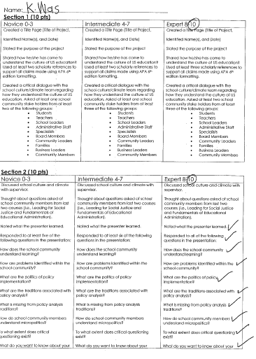
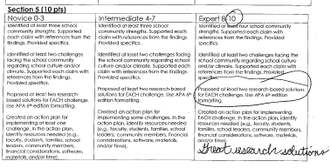
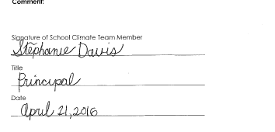

Slide 44
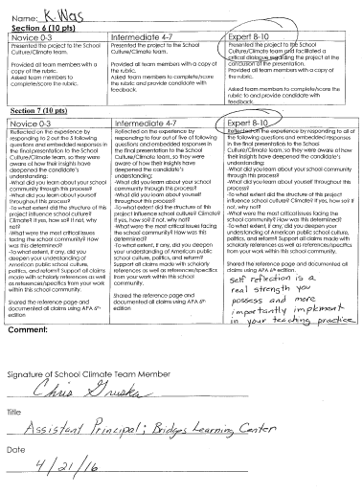
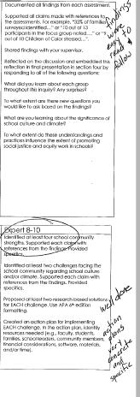
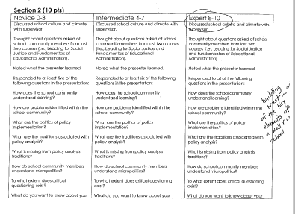

Slide 45
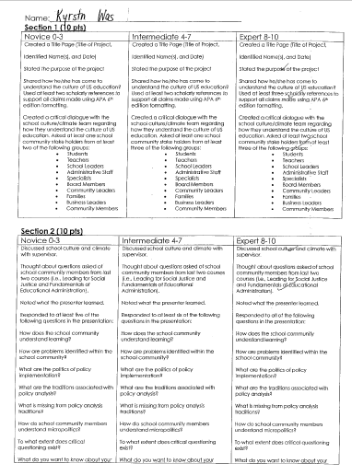
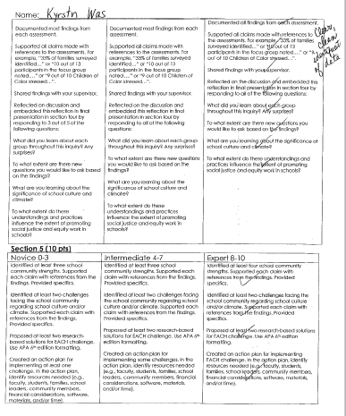
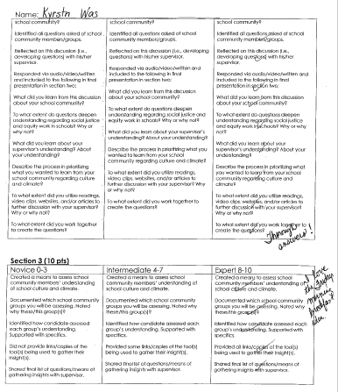
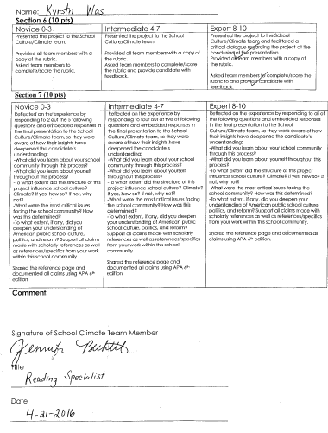

Slide 46
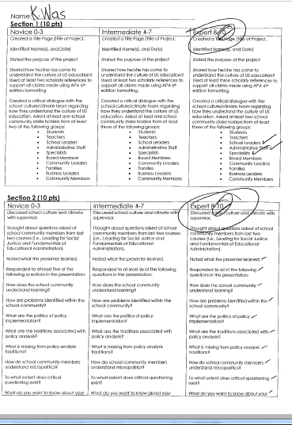
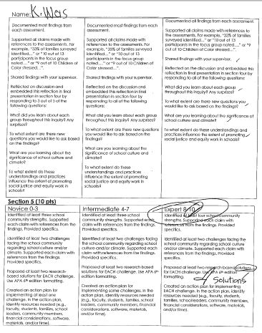
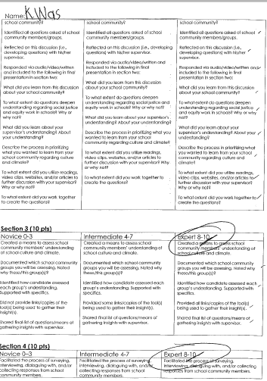
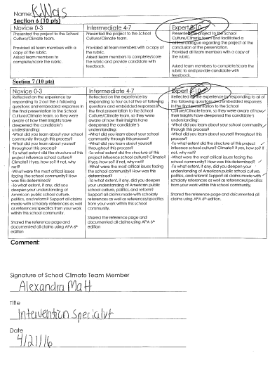

Slide 47
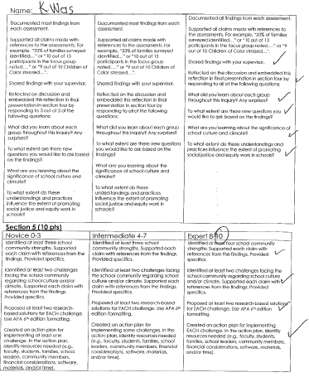
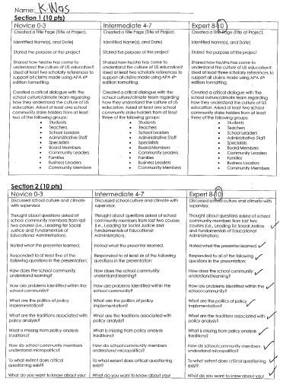
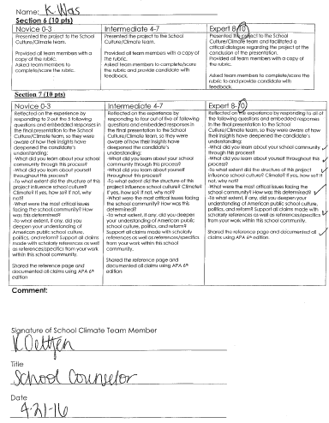
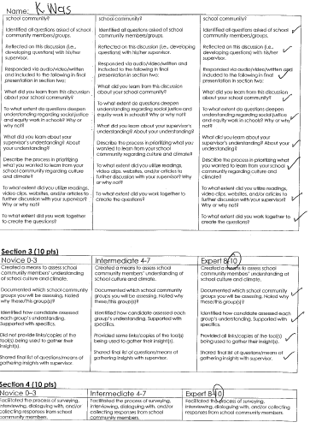

Slide 48
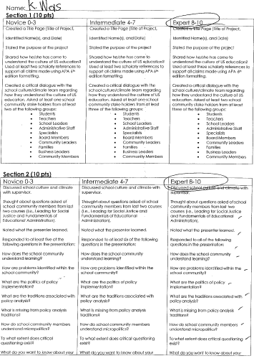
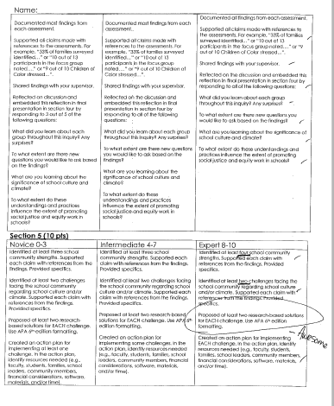
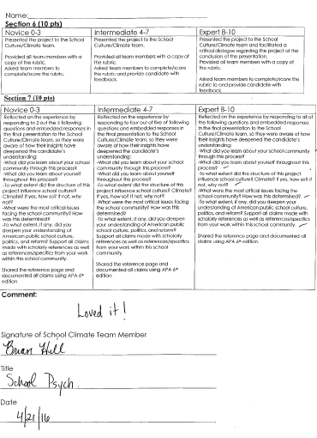

Slide 49
Section 7
Self-reflection

Slide 50
Self-reflection
What did you learn about your school community through this process?
I learned through this process that my school community is deeply committed to the students at Bridges Learning Center.
What did you learn about yourself throughout this process?
I learned about myself throughout this process that I too am deeply committed to Bridges Learning Center. I have had several opportunities to move educational settings within my district, but it is through my drive and commitment to this population of students that keeps me at this school.
To what extent did the structure of this project influence school culture? Climate? If yes, how so? If not, why not?
The structure and design of this project influenced the school culture and climate by identifying two challenges facing our school. With research-based solutions, an action plan was created along with a timeline for implementation to address the two challenges: staff retention and improving the connection from home to school to expand parental involvement.

Slide 51
Self-reflection
What were the most critical issues facing the school community? How was this determined?
The most critical issues facing the school community are the two challenges, staff retention and improving the connection from home to school to expand parent involvement. This was determined through dialogue with the building principal, common belief survey, and dialogue with the School Climate Team.
To what extent, if any, did you deepen your understanding of American public school culture, politics, and reform?
This project and research has deepened my understanding of American public school culture, politics, and reform. Schools today are faced with the constant changes within the political arena that impact the direction and focus of public schools. Privatization, commodification and deregulation are the new guiding categories through which schools, teachers, pedagogy and students are defined (English (2014). English (2014) explains perfectly how I feel,
“Most academics in the schools of education I know believe in the virtue of the common good. They believe in social justice. They see the schools as vital to the security of the nation and the promise of that nation reaching the highest ideals for all” (p. 57)

Slide 52
References

Slide 53
Batey, C. S. (1996). Parents are lifesavers: A handbook for parent involvement in the schools. Thousand Oaks, CA: Corwin Press, Inc.
English, F. (2014). Educational leadership in the age of greed. NCPEA Publications
Feinman-Nemser, S., Carver, C., Schwille, S., Yusko, B, (1999). Beyond support: taking new teachers seriously as learners’, In Schere, M. (Ed.). A Better Beginning: Supporting and Mentoring New Teachers, Alexandria, VA, Association for Supervision and Curriculum Development, pp.3-12.
Marshall, C., & Gerstl-Pepin, C. (2004). Reframing educational politics for social justice. Thousand Oaks, CA: Allyn Bacon.
Marshall, C. & Oliva, M. (2006). Leadership for social justice: Making revolutions in education (2nd Ed.). Boston, MA: Pearson/Allyn and Bacon.
Marzano, R. J., Waters, T., & McNulty, B. A. (2005). School leadership that works: From Research to results. Alexandria, VA: Association for Supervision and Curriculum Development.
Moir, E. (1999). The stages of a teacher’s first year. In Sherer, M (Ed). Better Beginnings: Supporting and Mentoring New Teachers. Alexandria, VA, Association for Supervision and Curriculum Development, pp.19-23.
Tomlinson, S.G. (1996). Welcoming parents at your school: Strategies that work. (Special Report). ERIC Clearinghouse on Reading, English, and Communication, Bloomington, IN. http://files.eric.ed.gov/fulltext/ED404703.pdf

