Slide 1
Equity audit. Bridges Learning Center
Kyrstn Was

Slide 2
Section 1
Discussion with School Leaders

Slide 3
Equity Audit.
What is an Equity Audit?
An Equity Audit looks at the educational policies, practices and programs necessary to:
.Eliminate educational barriers based on
gender, race/ethnicity, national origin, color,
disability, age, or other protected group status
.Provide equal educational opportunities and
ensure that historically underserved or
underrepresented populations meet the same
rigorous standards for academic performance
expected of all children and youth (Skrla, McKenzie, & Scheurich, 2009).

Slide 4
Equity Audit.
An Equity Audit uses data to determine how schools can best serve the needs of ALL students.
Data used:
Teacher Equity
+ Programmatic Equity
Achievement Equity

Slide 5
Systemic Equity.
Systemic equity is defined as the transformed ways in which systems and individuals habitually operate to ensure that every learner in whatever learning environment that learner is found- has the greatest opportunity to learn enhanced by the resources and supports necessary to achieve competence, excellence, independence, responsibility, and self-sufficiency for school and for life (Skrla et. al., 2009).

Slide 6
Process.
Conversation with Administration
.Met with the building principal and assistant principal to discuss the equity audit project.
.The building principal and assistant principal both acknowledged they have NO understanding or knowledge with an equity audit.
.What is equity?
.Building principal: Fair and equal
.Assistant principal: Fair opportunities for success for ALL students
.What is systemic equity?
.Building principal: Systems within the school are designed to provide equal opportunities for all students.
.Assistant principal: Not sure. Systems that make up a school.

Slide 7
Components of an Equity Audit.
.Teacher Equity
.Programmatic Equity
.Achievement Equity

Slide 8
Section 2
Equity Audit Team Members

Slide 9
Equity Audit Team Members.
.Kyrstn Was: Instructional Coach
.Stephanie Davis: Principal
.Krissy Oeltjen: School Counselor
.Brian Hill: School Psychologist
.Chris Gruska: Assistant Principal
.Kelly Rea: Intervention Specialist: 2nd Grade
.Kim Romanski: Intervention Specialist: 2nd Grade
.Alexander Matt: Intervention Specialist: 3rd Grade
.Melissa McGlone: Intervention Specialist: 3rd Grade
.Jennifer Bechtel: Title 1 Reading Teacher

Slide 10
Equity Audit Team Members.
The equity audit team members were selected / asked to serve as a member of this project because each person currently is a member of the School Leadership Team (SIP) at Bridges Learning Center.

Slide 11
Section 3
School and Community Understanding of Systemic Equity

Slide 12
School and community understanding of systemic equity

Slide 13
Investigation.
.When asked what systemic equity was, everyone asked (members of the Equity Audit Team) had no understanding of what it means, but speculated it dealt with “equal.”
.Most staff felt there are issues with the design of our school in relation to others in the district. “If the district truly wanted an equal education for ALL students, they would set up our school to focus on behaviors first, then academics. Being the behavior school, that should be our first priority.”
.The over arching theme and statement from staff was, “Our school is perfectly designed to get the results we are getting.”

Slide 14
Section 4
School Description

Slide 15
School Description

Slide 16
School Stats.
.K-8 Alternative School
.An alternative school that includes enhanced support for children with emotional or behavioral needs.
.Students are placed from their home school.
.Typically students come from a NOW classroom, which is a self-contained classroom that addresses students with emotional or behavioral needs within their homeschool.
.There are rare instances where students are placed at our school from a general education classroom due to extreme behavior problems.
.Serving the most severe behaviors
.Students with Disabilities: 100%
.Economically Disadvantaged: 100%

Slide 17
School Stats.
.School is labeled in Priority School Status from the state.
.Duration of Priority Status is 3 years.
.This school year begins the second three year cycle in Priority Status.
. A Priority School is one that ranks in the lowest 5 percent of schools in Ohio in student academic performance.

Slide 18
School Stats.
Priority School Status Continued
.ALL new hires are interviewed internally by building principal and members of School Improvement Team.
.Implement strategies to recruit, place and train staff.
.Prevent ineffective teachers from transferring to Priority Schools.
.Retain only those in the Priority School determined to be effective.
.Provide job-embedded PD designed to build capacity and support staff from the Instructional Specialist.

Slide 19
Section 5
Teacher Quality Equity Data

Slide 20
Teacher Equity.
High quality teachers is a key factor that influences student achievement (Skrla et al., 2009).
High quality teachers as defined by NCLB (Skrla et al., 2009).
.Certified / licensed
.College degree
.Demonstrated content knowledge

Slide 21
Teacher Equity.
Focus:
.Teacher Education
.Teacher Certification
.Teacher Experience
.Duration in Current Building
These 4 components can show a clear pattern of equitable or inequitable access to the most qualified teachers (Skrla et al., 2009).

Slide 22
Teacher Equity.
.13 certified teachers are necessary for the day-to-day operation of our building.
.ALL teaching staff must be a certified intervention specialist.
.Currently, the school has 3 long term substitute teachers.

Slide 23
Teacher Equity.
.The information is based on ten full-time teachers.

Slide 24
Teacher Equity.
.The information is based on ten full-time teachers.

Slide 25
Teacher Equity.
Ed Assistants | Education: | Years Assisting | Years in Building
K: Joyce | BS (Elem. Ed) | 1 ½ | 1 ½
1/2: Mrs. G |  | 18 | 18
2: Substitute |  | * | *
3: Dinnen | BS (Business) | 2 | 3
3: Fitzpatrick | BS (SPED) | 4 | 2
4: Substitute |  | * | *
5: McFarran |  | 10 | 14
5: Mosley |  | 8 | 4
6: Substitute |  | * | *
6: Substitute |  | * | *
6: Flinn |  | 10 | 8
7: Flosey |  | 1 | 1
8: Daditch |  | 2 | 2
Floater: Meeks | BA (Criminal Justice & Social Work) | 1 | ½
Floater: Bentley |  | 18 | 15
Floater: Castner |  | 20 | 15
.Each classroom has an educational assistant, 13 required, with 3 floaters for additional support.
.Currently, the school has 3 substitute educational assistants.

Slide 26
Teacher Equity.
Key Staff Members | Education: | Years of Service in current position | Years in Building
Principal: Davis | BS (SPED), MEd (SPED), Admin License | 1 | 2
Assist. Principal: Gruska | BS (SPED) & MEd (Admin) | ½ | ½
Instructional Coach: Was | BS (Elem Ed)& MEd (SPED), | 4 | 8
Title 1: Becktel | BS (Elem. Ed) & Reading endorsement | 12 | 1
Counselor: Oeltjen | BS (Gen Ed) & MA (School Counseling) | 2 | 3
Focus:
.Schools Leadership Team
.Administration Team are newly licensed administrators.
.This is the Administration Team’s first assignment with their current licensure.

Slide 27
Section 6
Programmatic Equity Data

Slide 28
Programmatic Equity.
Focus:
.Special Education
.Gifted & Talented
.Bilingual
.Discipline

Slide 29
Programmatic Equity.
Enrollment by Subgroup
.100% of population are Students with Disabilities
.80 students

Slide 30
Programmatic equity.
.80 students

Slide 31
Programmatic Equity.
.80 students

Slide 32
Programmatic equity.
.80 students

Slide 33
Programmatic equity.
.80 students

Slide 34
Programmatic equity.
.According to the Department of Education’s, Institute of Education Sciences, the definition of instructional time is simply “the portion of the school day that is allocated to instruction.”
.The most prevalent behaviors leading to individual (or class) Instructional Time Lost: .throwing substantial classroom items (desks & chairs) .physically aggressive towards peers or staff .threatening peers (bullying)
.Leaving classroom
.Running the halls
.Excessive verbal disruptions: profanity, yelling/screaming

Slide 35
Programmatic equity.
Instructional Time Lost: Male: 72 students
Instructional Time Lost
.Time indicated as time out of the learning environment.
.Students are in secure out-of-class Timeout
.Students are in a Support Room Environment

Slide 36
Programmatic equity.
Instructional Time Lost: Females: 8 students
Instructional Time Lost
.Time indicated as time out of the learning environment.
.Students are in secure out-of-class Timeout
.Students are in a Support Room Environment

Slide 37
Programmatic equity.
.Data reflects 2015-2016 school year (Data ended 11/20/15)
.The data represents male Black students.
.6th grade data is based on 2 students:
Student A: 2 charges
Student B: 5 charges

Slide 38
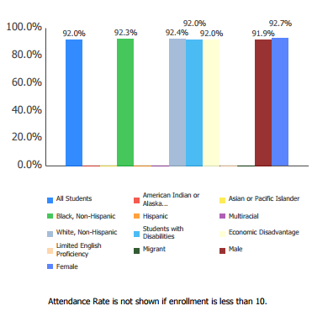
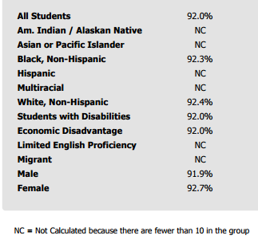
Programmatic Equity.
Attendance Rate

Slide 39
Section 7
Achievement Equity Data

Slide 40
Focus:
.State Achievement Assessments
.Drop Out Rates
.High School Graduation Tracks
.SAT/ACT/AP/IB results
These are the 4 indicators that represent student achievement (Skrla et al., 2009).
State Achievement Assessments will be represented due to being a K-8 building.

Slide 41
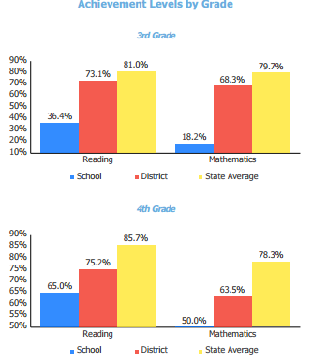
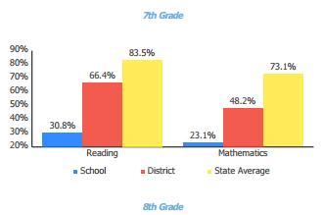
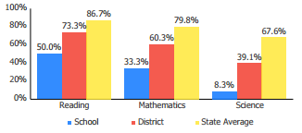
Achievement Equity.

Slide 42
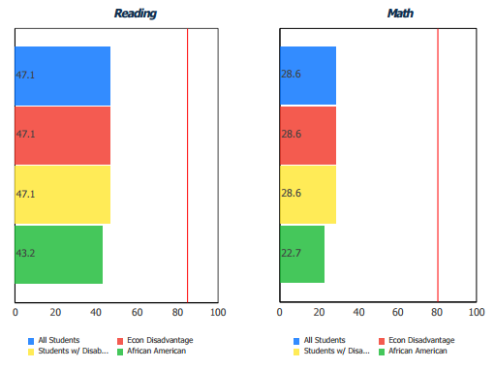
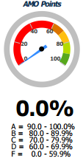
Achievement Equity.
Annual Measurable Objective (AMOs): Compare the performance of student groups to a state goal which is displayed as the red line. These charts show how well each group achieved that goal in reading and math. The chart emphasizes achievement gaps that exist between groups. The ultimate goal is for all groups to achieve at high levels

Slide 43
Section 8
Documentation of Conversations on Equity

Slide 44
Discussions about equity.
Focus:
.Documentation of Conversations on Equity with:
.Principal
.Assistant Principal
.Equity Audit Team
.Teachers

Slide 45
Discussions about equity.
Conversations with both Building Principal and Assistant Principal About Equity in the Educational Program and data collected.
.What is equity now that you both have a better understanding?
Building Principal: …fair and treatment. Giving everyone the same opportunities.
Asst. Principal: Giving people what they need to have equal opportunities.
.What is systemic equity?
Building Principal: Systems and individuals that operate within a learning environment
Asst. Principal: The systems that operate within a learning environment that work in conjunction with the individuals that ultimately allow the system to run.
.Based on the results in the equity audit, what are your thoughts?
Building Principal: There are significant issues getting quality and effective teachers.
Asst. Principal: Staffing…Biggest issue!

Slide 46
Discussions about equity.
Conversations with Equity audit team and other teachers about Equity in the Educational Program and data collected.
.When asked about equity now that they had a better understanding of the process most responded equal opportunities that are fair and equal for everyone.
fair and treatment.
.When asked what systemic equity is now that they have a better understanding people responded, “the system and individuals working together,” “the learning environment that operates in conjunction with the systems and the individuals that run it.”

Slide 47
Section 9
Findings & Conclusions Drawn from Data

Slide 48
Focus:
.Findings and Conclusions drawn from data

Slide 49
Findings and Conclusions drawn from data:
.There is a significant amount of instructional learning time that is lost due to extreme behaviors that have students removed to a secure support room setting.
.The most extreme behaviors occurred during the lunch periods from 11-12pm.
.49% of the students placed at Bridges came from the Buchtel Cluster.
.Reading and Math achievement scores are significantly below district and state achievement levels for third through eighth grade students.

Slide 50
Findings and Conclusions Continued:
.The operation of the school requires 13 full time intervention specialist (Special Education Certified) and the school currently functions with 3 long-term substitutes.
.Out of the 10 teachers, 2 have been teaching less than 2 years and 3 less than 10 years.
.The operation of the school requires 13 full time educational assistants to work along side each classroom teacher and the school currently functions with 3 long-term substitutes.
.First assignment for building principal and assistant principal with their administration licensure.
.This is the second time Bridges has been placed in Priority Status (3 year cycle) from the state.

Slide 51
Section 10
Researched-based Solutions

Slide 52
Focus:
.Research-based Solutions

Slide 53
Researched-based Solution: Challenge 1:
.Full Implementation (Fidelity) with School-Wide PBIS:
Universal Behavioral Expectations and Positivity.
Positive Behavior Interventions and Supports (PBIS) is a proactive approach to establishing the behavioral supports and social culture needed for ALL students in school to achieve social, emotional and academic success (Browning-Wright, D., Mayer, G.R., Cook, C.R., Crews, S.D., Gale, B., & Wallace, M., 2007). Students who engage in behavior problems early on are highly likely to continue to engage in behavior problems into the secondary grades and beyond (Moffitt, 1998; Walker, Ramsey, & Gresham, 2004). Bridges needs to implement with fidelity the universal PBIS system grades K-8.

Slide 54
Researched-based Solution: Challenge 1 Continued:
The Components of School wide PBIS:
.Plan for systematic, direct instruction to ALL staff with ALL the necessary components for proper implementation of PBIS.
.Clear definitions of expected appropriate, positive behaviors.
.Positive reinforcement for good behavior
.Clear definitions of problem behaviors
.Consequences are defined for students and staff members.
.Intervene with high quality supports
.Use student response data to determine need for less or more intensive services
.Regularly scheduled instruction and assistance in desired positive social behaviors.
.Effective incentives and motivational systems encourage students to behave differently.
. Rewards for achievements
. Celebrating the little things (rejoice with students)
.Monthly school wide PBIS incentive for students achievements
.Staff receives on-going training, feedback and coaching about effective implementation of the systems.
.Systems for measuring and monitoring the intervention's effectiveness are established and carried out.

Slide 55
Researched-based Solution: Challenge 2:
.Strategies to recruit and train “new” teachers.
Create a mentoring program with lead teachers from within the building will provide new teachers with necessary resources that are specific to this building. For anyone, regardless of preparation, the first year of teaching in a new building, district or fresh out of college is challenging. Sometimes the expectations of learning new board adopted curriculum and the fundamentals that make a building unique can become overwhelmed. When extreme behavior is added, a new teachers may become emotionally and/or physically exhausted (Moir, 1999) .
Implications for the Mentor:
New teachers need 2 type of support at Bridges
.The NOW Program: No Opportunity Wasted
.Level System, Group Meeting, Goal Setting, on going support
.It is a proven fact that when better relationships are formed the disciplinary issues decrease (Friere, 1970).
.Psychological Support
.Sense of self as a teacher
.A teacher who does not develop his or her identity of the teacher will
continue to flounder and likely leave the profession (Kagan, 1992).
.Ability to handle stress
.Avoiding blows to self-esteem from classroom struggles (Feinman-Nemser, S., Carver, C., Schwille, S., Yusko, B, 1999).

Slide 56
Researched-based Solution: Challenge 3:
.School Mentors: Check in/Check out.
School-based mentoring is one of the fastest growing forms of mentoring. Students with the most at-risk behaviors or are needing additional supports are linked with one adult within the building to check in and check out daily during the school day. The Student receives support and guidance weekly during structured time built within the school schedule. The mentor also works in conjunction with the teacher to create a positive relationship with the family. The mentor has regular feedback to the teacher to reinforce on-going support with the mentoring program (Hawken, L. & Horner R., 2003).
Mentors Role:
.Provide unconditional positive regard, but holds student accountable to behavior
.Meet with student regularly
.Check on work, effort, attitude, grades
.Offer guidance and support (Hawken, L. Pettersson, H., Mootz, J. & Anderson, C., 2005)

Slide 57
Section 11
Documentation of Presentation to Equity Audit Team

Slide 58
Focus:
.Documentation of Presentation
.3 Year Action Plan

Slide 59
3 year Plan.
Year 1 | What is to be accomplished? PBIS implemented with fidelity building wide. Teacher Mentoring program and student check In/Check Out implemented building wide. | Is it working? Data is collected for the PBIS system with individual student punch cards. Teachers/ed assistants will also record data. Teacher mentoring program will be surveyed quarterly to gage the effectiveness. Check In/Check Out mentors will meet with mentees at 3 “check ins” daily: Breakfast, Lunch, and Dismissal. The program will use a progress monitoring tool at each “check in” based on a rating scale. All data will be collected to determine the next steps. | Carried out by? ALL staff, lead teachers/mentors, Leadership Team, Building Principal, Assistant Principal
.Year 1

Slide 60
3 year Plan.
Year 2 | What is to be accomplished? During professional development days at the beginning of the school year, have a refresher training for staff covering PBIS for effective school wide implemented. Continue with the Teacher Mentoring program and student Check In/Check Out implemented building wide. Decide as a School Improvement Team if the Check In/Check Out program should be used with ALL students. | Is it working? Data collection will continue for the PBIS system with individual student punch cards. Teachers/ed assistants will also record data. Teacher mentoring program will be surveyed quarterly to gage the effectiveness. Check In/Check Out mentors will meet with mentees at 3 “check ins” daily: Breakfast, Lunch, and Dismissal. The program will use a progress monitoring tool at each “check in” based on a rating scale. All data will be collected to determine the next steps. | Carried out by? ALL staff, lead teachers/mentors, Leadership Team, Building Principal, Assistant Principal
.Year 2

Slide 61
3 year Plan.
Year 3 | What is to be accomplished? During professional development days at the beginning of the school year, have a refresher training for staff covering PBIS for effective school wide implemented. Discuss what incentives will motivate students. Teacher Mentoring program and student check In/Check Out implemented building wide. | Is it working? Data collection will continue for the PBIS system with individual student punch cards. Teachers/ed assistants will also record data. Teacher mentoring program will be surveyed quarterly to gage the effectiveness. Check In/Check Out mentors will meet with mentees at 3 “check ins” daily: Breakfast, Lunch, and Dismissal. The program will use a progress monitoring tool at each “check in” based on a rating scale. All data will be collected to determine the next steps. | Carried out by? ALL staff, lead teachers/mentors, Leadership Team, Building Principal, Assistant Principal
.Year 3

Slide 62
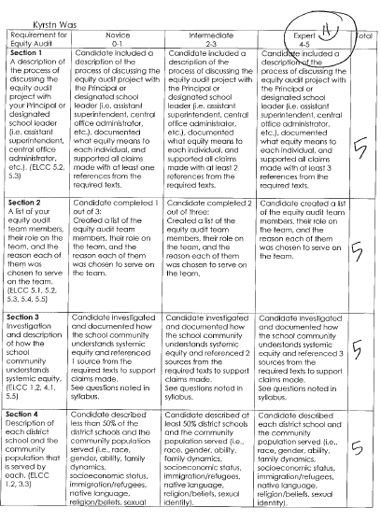
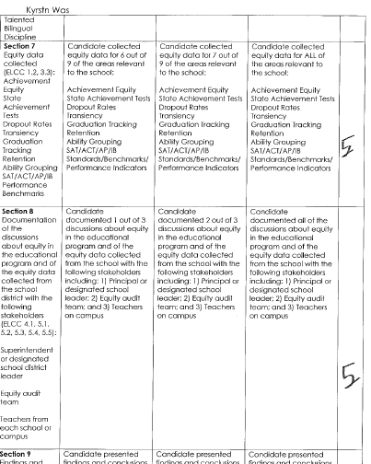
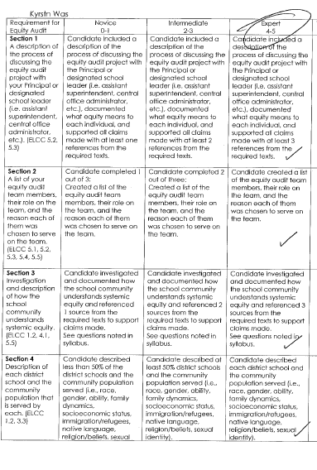
Documentation of Presentation.
.Equity Audit was presented Monday November 23.
.Out of the 9 members of the Equity Audit Team, only 4 attended.
.The Equity Audit will be viewed at December’s SIP monthly meeting.

Slide 63
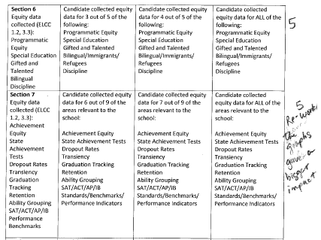
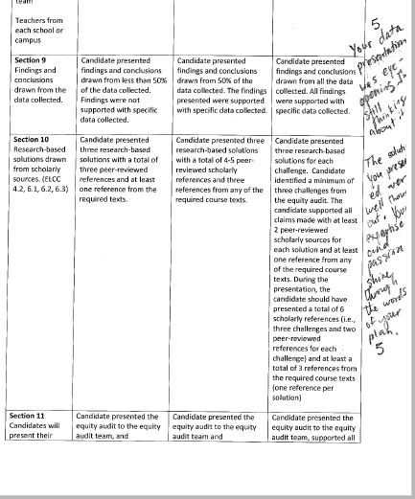
Documentation of Presentation.
.Equity Audit was presented Monday November 23.
.Out of the 9 members of the Equity Audit Team, only 4 attended.
.The Equity Audit will be viewed at December’s SIP monthly meeting.

Slide 64
Section 12
Written Reflection on Educational Equity in Schools

Slide 65
Focus:
.Written Reflection

Slide 66
To what extent did this equity project increase consciousness about equity in schools for team members? Part A
I have learned that people can be on many stages in equity consciousness and the discussion must continue. All of the team asked to serve on this project at first had minimal understanding what equity or systematic equity were and how each impact students. Skrla et al. (2009) best describe what it means to increase consciousness about equity in schools, “By equity consciousness we mean that teachers are aware of, accept and act on four central beliefs: 1. That all children (except only a very small percentage, e.g. those with profound disabilities) are capable of high levels of academic success. 2. That all children means all, regardless of a child’s race, social class, gender, sexual orientation, learning differences, culture, language, religion and so on. 3. That adults in schools are primarily responsible for student learning. 4. That traditional school practices may work for some students but are not working for all children. Therefore, if we are going to eliminate the achievement gap, it requires a change in practices .”(p. 83)

Slide 67
To what extent did this equity audit project increase consciousness about equity in schools for you as an aspiring leader? Part B
My equity consciousness has increased by completing the equity audit. Gathering and analyzing data to discuss and draw conclusions allowed me to truly see the need for authentic equity consciousness in schools. As an aspiring leader, this equity audit leaves me with the responsibility to figure out experiences for ALL teachers and staff that serve students meaningful ways to develop our school’s equity consciousness (Skrla, et al., 2009).
What did you learn about yourself as an instructional leader?
A huge part of instructional leadership is modeling the desired attitudes and behaviors you want ALL staff to show. By setting the tone and attitude of the building, staff will see and model the desired tone and attitude they see. This modeling respectful and culturally responsive interactions, a caring principal-teacher relationships, principal modeling respect and cultural responsiveness, skilled mentor-teacher modeling respect and cultural responsiveness, schools will flourish (Skrla, et al., 2009)

Slide 68
What did you learn about yourself as a leader for social justice and equity in relation to those you serve?
I learned that as a leader for social justice, I need to be a persistent advocate for ALL my students. I learned that this change will not occur overnight or without uncomfortable conversations. The data showed a need for some uncomfortable conversations about teacher equity, programmatic, especially discipline, and student achievement. I have to be the voice that starts the change. As Skrla et al. (2009) said, “There are easily hundreds of different ideas, but the main point is to start with your assets and build them up.” (p.77)
What did you learn about addressing issues of educational equity within your school?
Skrla et al. (2009) best summed up what my experience was when discussing equity with fellow educators, “…understand that many educators might want to argue that the inequities in these areas are somehow produced by nature or by society and that we educators can do little to change them.” (p. 46) As a school, we will not be able to address the situation of inequity in our school until everyone takes ownership of the problem.

Slide 69
What does it mean to speak truth to people about the reality of their lives?
This is one of the most difficult issues facing human beings now. The thought of upsetting people by speaking the truth prevents most people from dealing with someone's upset. Most people place either their ego or themselves in the way of speaking the truth instead of having courageous conservations (Skrla, et al., 2009). The truth is that we continue to live in an oppressive society. We are either the oppressor or the oppressed. Many are unaware of the deep systemic oppression and/or are comfortable with their position of privilege. This is evident with all the rhetoric being “spread” as truth from politicians wanting our vote. They are the oppressors and the voters oppressed.
To what extent can this equity team equip school community members to resist oppressive practices/policies?
The equity audit team now has data to support claims about the inequities in the school. Further discussion are needed with colleagues. Since teacher equity and programmatic equity equal student achievement, the data proves the need to move to a more equitable school.

Slide 70
To what extent does this equity action plan move school community members into action?
The equity audit makes a case for the importance of the teacher’s role, “That the adults in schools are primarily responsible for student learning.” (Skrla, et al., 2009) As Skrla et al. (2009) stated, “you need to keep reminding yourself what you focus is and keep communicating that focus.” (p.78) This focus will be the key to action evolving out of the data collected in the audit.

Slide 71
Resources.
. References
Browning-Wright, D., Mayer, G.R., Cook, C.R., Crews, S.D., Gale, B., & Wallace, M. (2007). Effects of training using the Behavior Support Plan Quality Evaluation Guide to improve positive behavior support plans. Education and Treatment of Children, 30, 89-106.
Cohen, M. (n.d.) A tradition of Excellence. ASCD Express. Retrieved November 2015, from Educational Leaders: http//ww.ascd.org/ascd-express/vol5/501- cohen.aspex
Feinman-Nemser, S., Carver, C., Schwille, S., Yusko, B, (1999). Beyond support: taking new teachers seriously as learners’, in Schere, M. (ed.), A Better Beginning: Supporting and Mentoring New Teachers, Alexandria, VA, Association for Supervision and Curriculum Development, pp.3-12.
Hawken, L., & Horner R., (2003). Implementing a targeted group intervention within a schoolwide system of behavior support. Journal of Behavioral Education, 12, 225-240.
Hawken,L., Pettersson, H., Mootz, J., & Anderson, C., (2005). The behavioral education program: a check-in, check-out intervention for students at risk. New York, NY: Guilford Press.
Moir, E. (1999). The stages of a teacher’s first year. In Sherer, M (Ed). Better Beginnings: Supporting and Mentoring New Teachers. Alexandria, VA, Association for Supervision and Curriculum Development, pp.19-23.

Slide 72
Resources.
. References Continued
Ohio Department of Education. (2015, October 15). Retrieved from Ohio Department of Education: http://education.ohio.gov/Topics/Data/Accountability-Resources/Ohio- Report-Cards/State-Local-Cards-and-Resources
PBIS Positive Behavioral Interventions & Supports. (2015, November 19). Retrieved from https://www.pbis.org/
Skrla, L., McKenzie, L.B. & Scheurich, J.J.(2009) Using equity audits to create equitable and excellent schools. Thousand Oaks, CA: Corwin Press.

